Slide 1
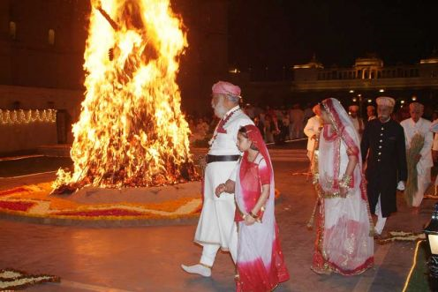
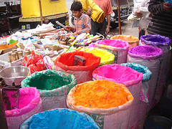
GGKLI-Culture Class Group 1
WHAT IS HOLI ?
Holi is a famous and very popular Hindu spring festival in Northern India. It celebrates the arrival of spring flowers and when the main crops are almost ready for the spring harvest. The festival lasts anything from three to five days and is known as the festival of color.
Holi usually begins with the lighting of bonfires which have been built by everyone. People light their household fires, and then the community fire is kindled by a Brahmin priest. The ripening of the first wheat and barley crop is celebrated by being offered to the fire, and the roasted barley is eaten. The ashes of the fires are marked on the forehead to bring good luck in the year ahead.
After the bonfires comes the throwing of color. People throw colored water and red powders over friends or anyone who passes by. It is a happy celebration, everybody dances and has great fun. Processions of floats carrying statues of the gods line the streets.
Holi is named after the Holika. During the festival, people burn the image of Holika as a symbol that good has defeated evil. This is often followed by the burning of rubbish, to show that past wrongdoing is forgiven.

Slide 2
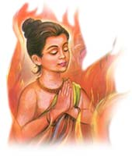
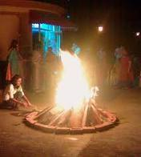
THE STORY OF HOLI
A story to read
There was once a very cruel king called Hiranyakashyap who had a son called Prahlad. Prahlad was very good and always prayed to the god Vishnu, which made his father very angry. The King tried very hard to make his son give up his belief in Vishnu.
So the King ordered his sister Holika to take Prahlad in her arms and for both of them to walk into the burning fire. The plan was that Prahlad would die and Holika would be saved because she was protected by the gods of flames. What the King did not know was that the gods' charm over Holika didn't work for one hour during the day. The hour chosen for lighting the fire just happened to be that very hour. When the flames leapt up, Holika died and Prahlad was saved by Vishnu.
Prahlad was so sorry for Holika that he promised to name a festival after her. So now we have the festival of Holi.

