Slide 1
Meat Eating Animal vs.
Non-meat Eating Animals vs.
Human Beings

Slide 2
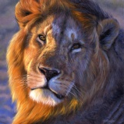
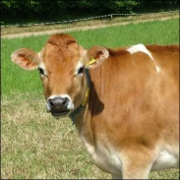
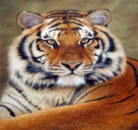
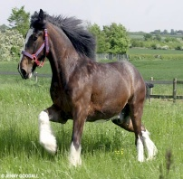
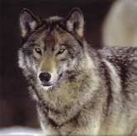
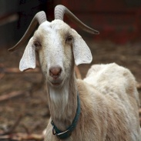

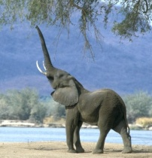

Meat Eating Animals
Non-meat Eating Animals
Lion
Tiger
Wolf
Cat
Dog
Cow
Horse
Goat
Elephant
Is a Human Being a Meat Eating or Non-meat Eating Animal?

Slide 3
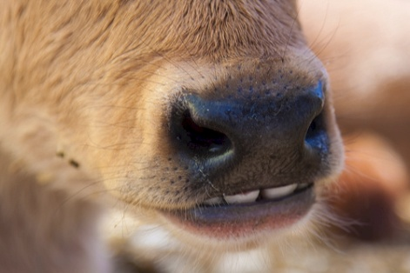
Meat Eating Animals
Non-meat Eating Animals
Teeth: Sharp and big
  Used to cut meat
Teeth: Not Sharp but Flat
  Used to eat grass and other vegetarian food. They do not need sharp teeth
Do Human Beings have Sharp Teeth?

Slide 4
Meat Eating Animals
Non-meat Eating Animals
Drinking Water: use their tongues
Drinking Water: use lips- they cannot drink with their tongue
Do Human Beings use their tongues when they drink water?

Slide 5
Meat Eating Animals
Non-meat Eating Animals
Intestine: they have a small intestine so meat does not stay long in their bodies
Intestine: they have a big intestine which is not suitable for meat
Do Human Beings have a big intestine or a small intestine?

Slide 6
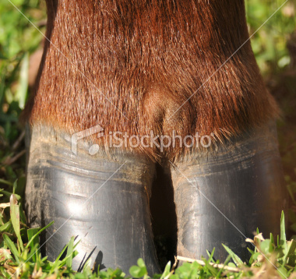
Meat Eating Animals
Non-meat Eating Animals
Nails: they have paws with sharp nails which is used to hold meat or to cut it.
Nails: they do not have sharp nails they do not need them to eat Grass or Veg. Food
Do Human Beings have sharp nails or fingers?

Slide 7
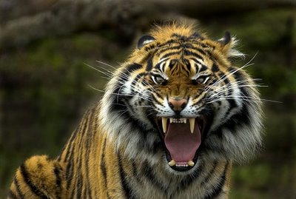
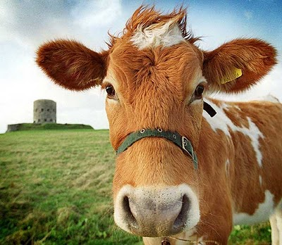
Meat Eating Animals
Non-meat Eating Animals
Behavior- they are always wild in nature
Behavior: they are very sober and soft in nature-due to their eating habits
Does food affect the nature of Human Beings?

Slide 8
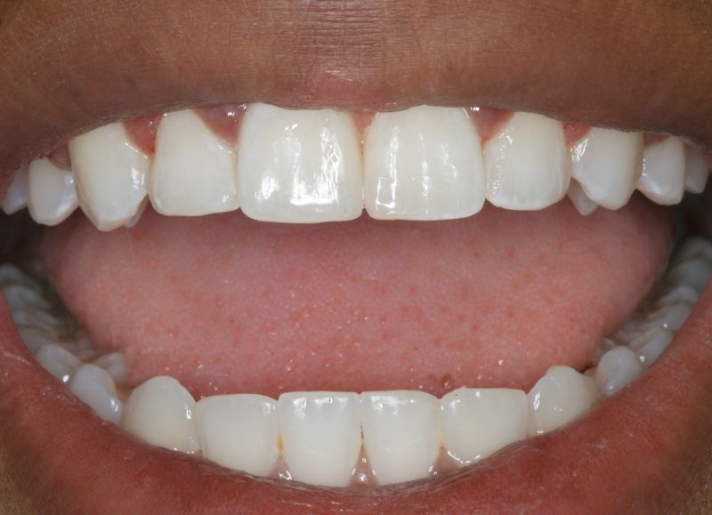
Teeth
Meat eating animals have sharp teeth to cut meat. Non-meat eating animals do not have sharp teeth as they do not require sharp to eat grass or vegetarian food. Human being do not having sharp teeth.

Slide 9
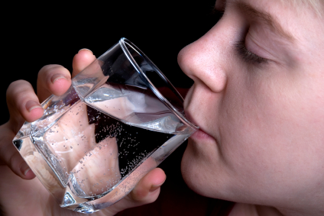
Drinking Water
Meat eaters drink water by using their tongue while non-meat eating animals drink water by using their lips. Human beings drinks water by lips.

Slide 10
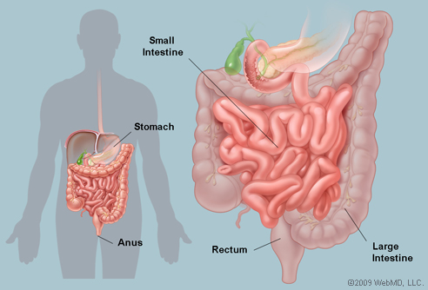
Intestine
Meat, if kept outside for more than 24 hrs, will start spoiling. It may carry germs of disease. The food that humans eat stays in the intestine for more than 24 hours before it is disposed of due to their big intestine and therefore, it starts decaying in body and invites many diseases. Meat Eating animal have short intestines and therefore, when they eat meat they disposes of it soon and it does not stay in the body.

Slide 11
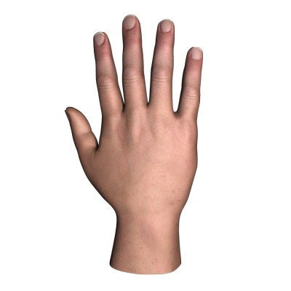
Nails
Meat eating animals have sharp nails in their paws while non-meat eaters have flat paws with no sharp nails. Human being do not keep sharp nails as it is not required to hold or cut meat.

Slide 12


Behavior
Meat eating animals are wild in nature while non-meat eating animals are sober and gentle in nature. Whatever they eat has an affect on the body as well as on the nature of the animal. Man has two choice: To eat meat or not to eat meat. What they eat affects their body and mind
Or

Slide 13
From the structure of the body of the human being given by god (nature), human being are non-meat eating animals. The body of the human being is not suitable for eating meat
Are human being meat eating animals or non-meat eating animals?
Should Human Being eat Meat?

